Slide 1
Distributed Computing & Spark with Azure Databricks
Avanade ASG Data Science Bootcamp

Slide 2
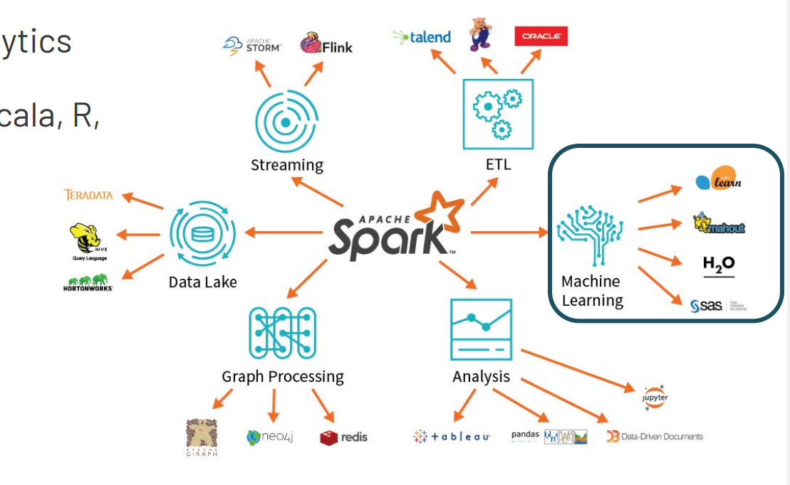
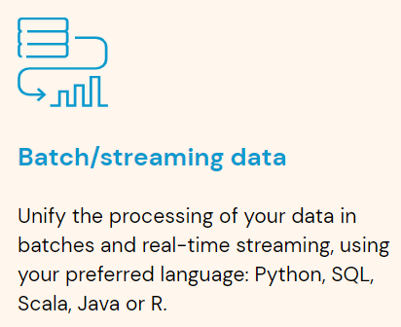
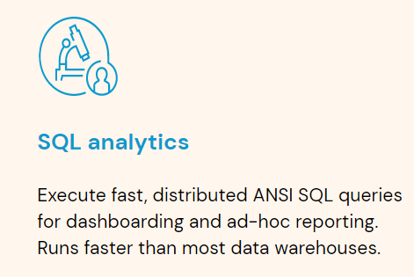
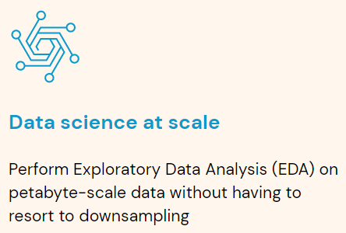
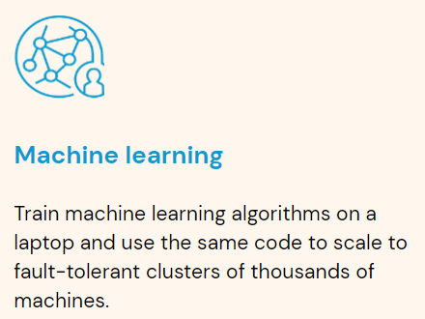
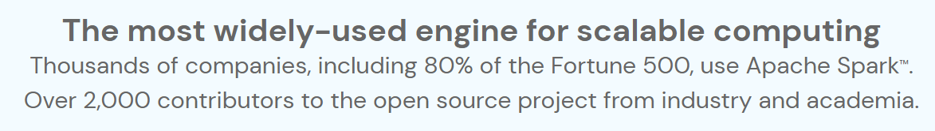
What is Spark? (1/2)
Apache Spark is a simple, fast, and scalable unified multi-language engine for large-scale data analytics
Unified: Data Engineering, Data Science, Machine Learning, Business Intelligence
Multi-language: High-level APIs in Python, SQL, Scala, Java, R
Large-scale: single-node machines or multi-node clusters

Slide 3
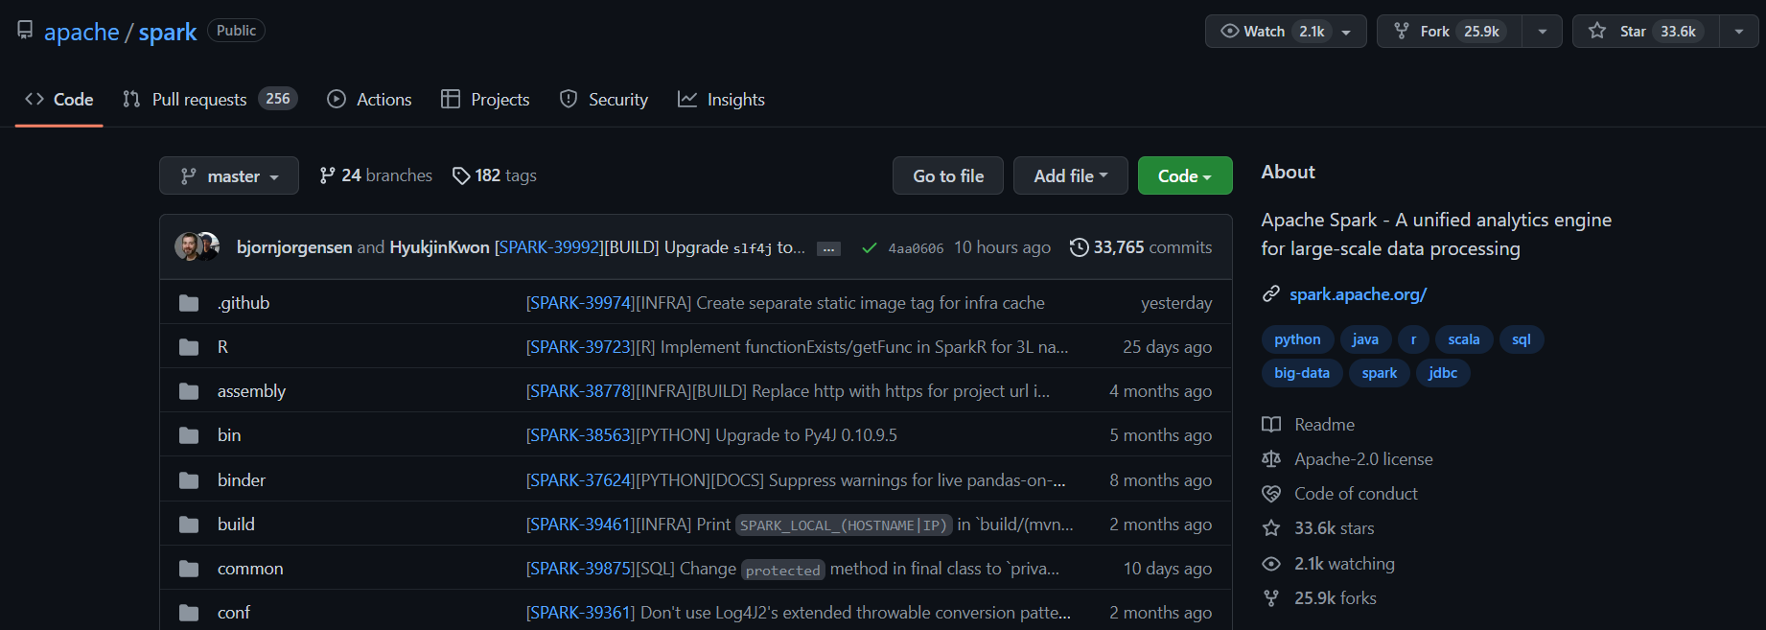
What is Spark? (2/2)
Spark is an open-source project written mostly in Scala, available on Github. This means that you could become a contributor!
https://github.com/apache/spark

Slide 4
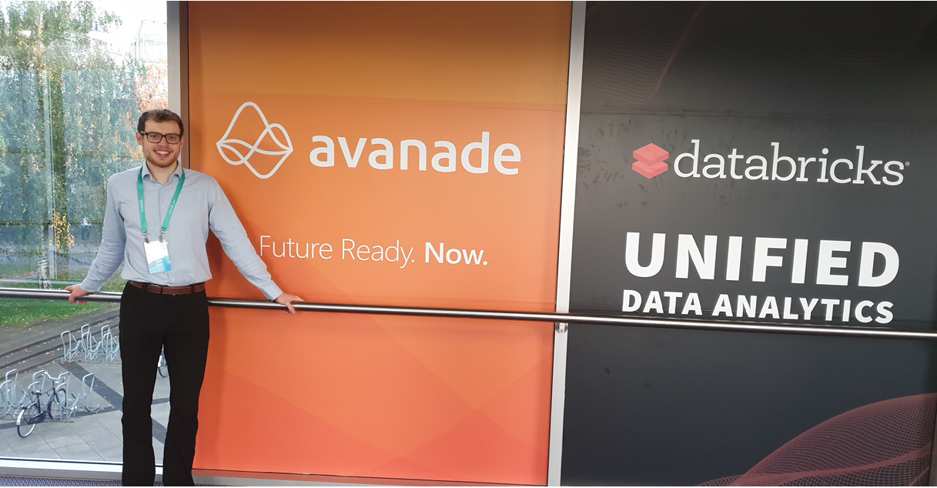
Spark & Databricks History
2009:
Spark starts as a research project at UC Berkeley in California by a couple of PhD students
2010:
Spark is open sourced
2013:
The project is donated to the Apache Software Foundation
The creators of Spark found a company called Databricks to offer a web-based platform for working with Spark
2014:
In February, Spark becomes a top-level Apache project
In November, Databricks sets a new world record in large scale sorting using Spark
2019
Spark & AI Summit in Amsterdam with 2300 people. Avanade first time named Databricks partner of the year
Today:
Spark: 600,000+ lines of code built by 1800+ developers from hundreds of organizations (main contributor: by far Databricks)

Slide 5
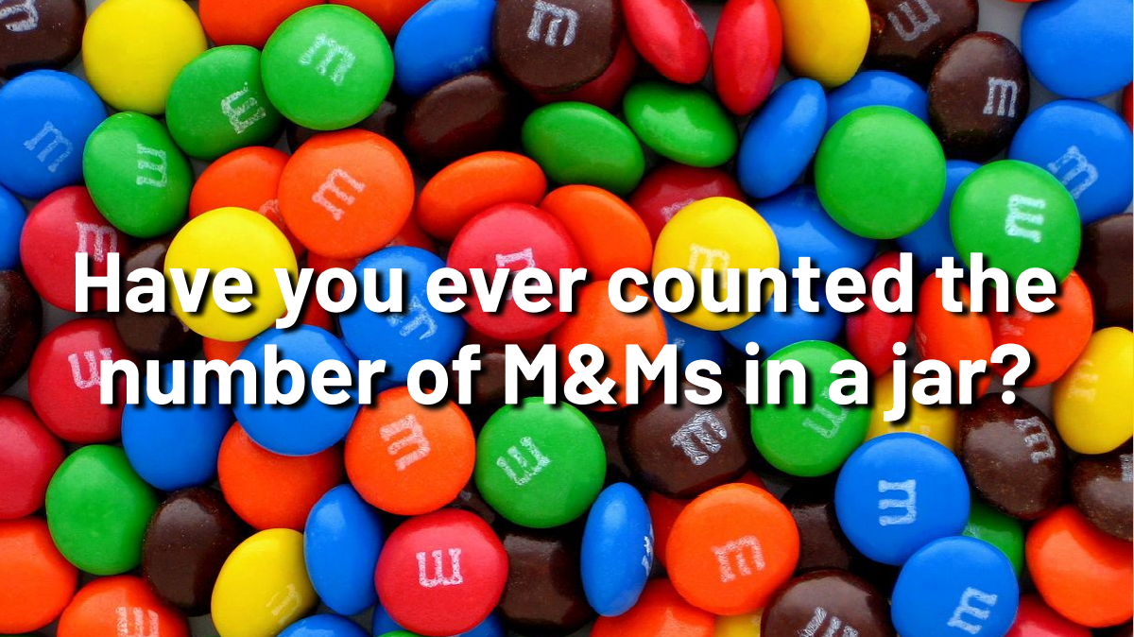
Motivation
Think of an effective (fast) strategy to do so
What resources do you need?
Which steps do you follow?

Slide 6
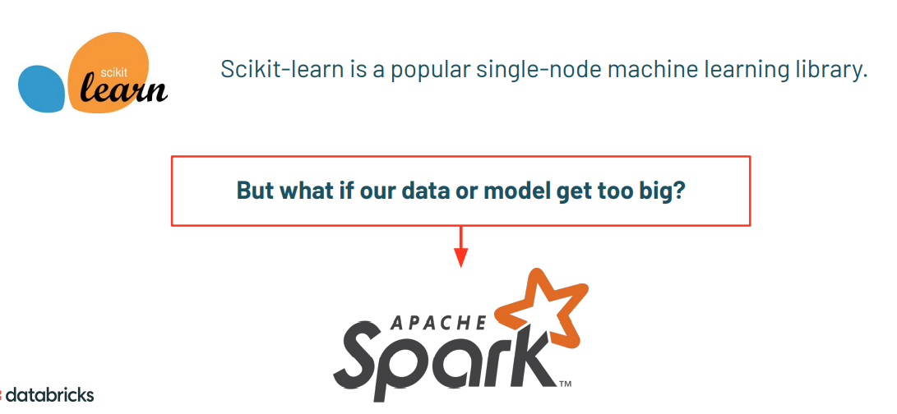
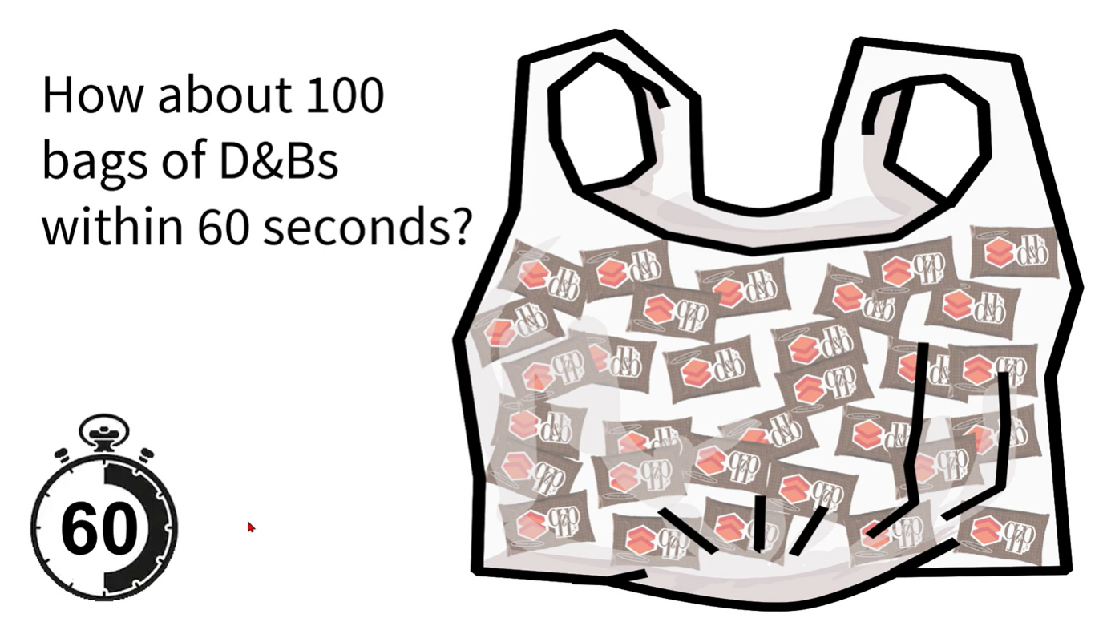
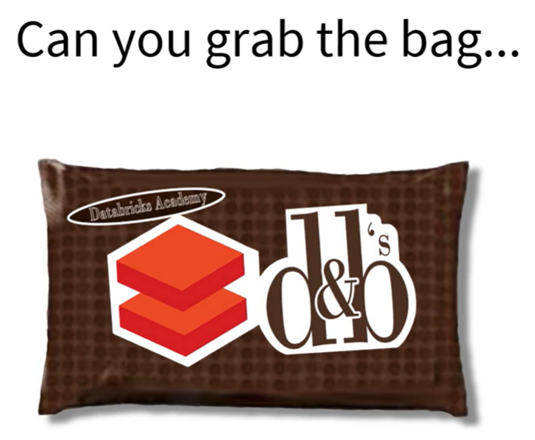
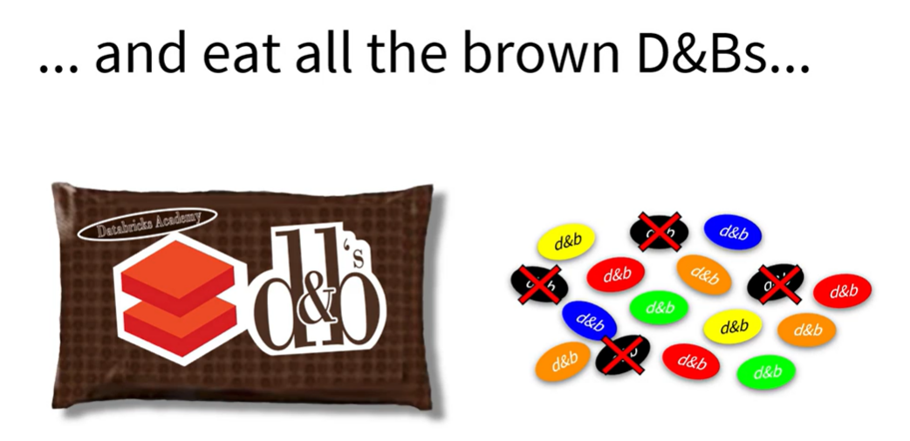
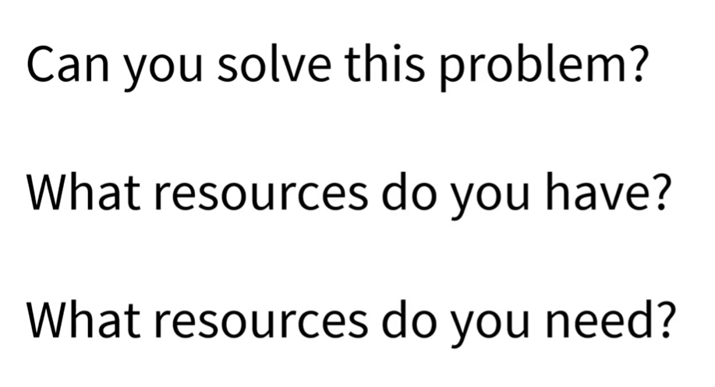
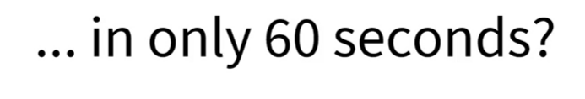
Motivation

Slide 7
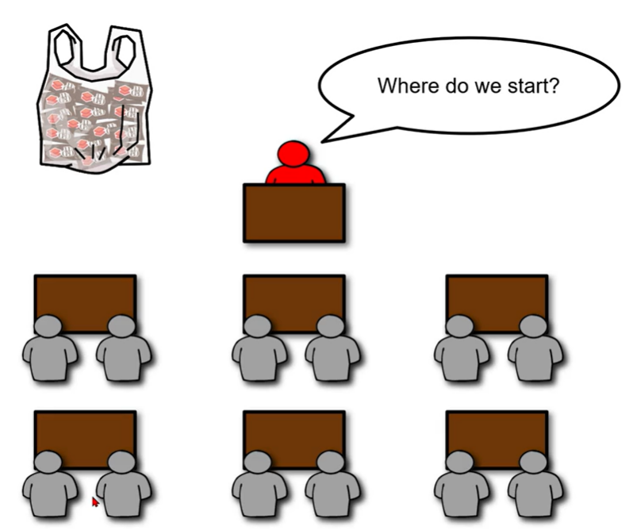
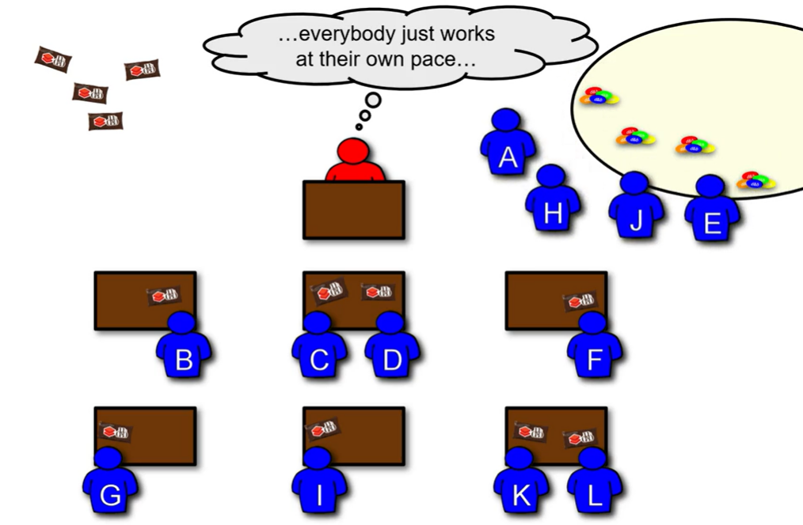
Motivation
https://partner-academy.databricks.com/learn/course/112/play/1702:303/introduction-to-apache-spark-architecture -> Filtering – The Analogy Video
Notes:
A table (or place to work)
A place from which one can retrieve the M&Ms and store them on count completion
People to process the M&Ms
An orchestrator

Slide 8
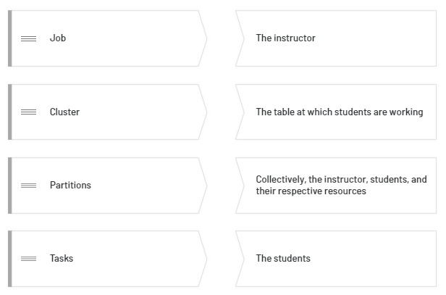
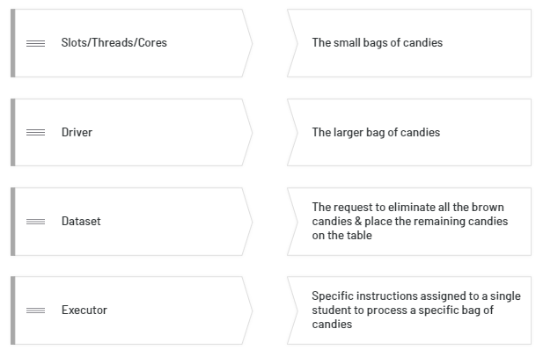
Spark Architecture
Task: match each Spark architecture concept with the respective component in the analogy

Slide 9
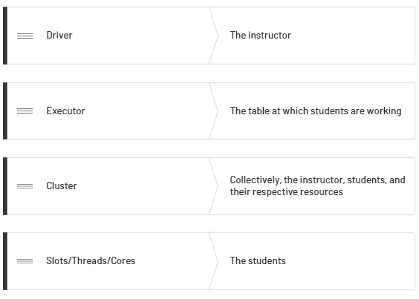
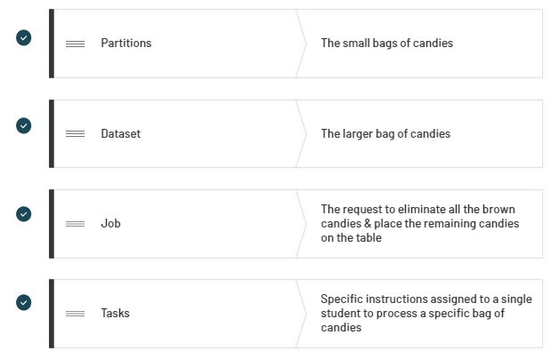
Spark Architecture
Solution

Slide 10

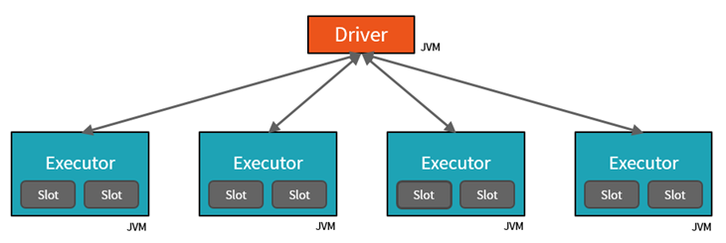
Spark Architecture Breakdown
https://partner-academy.databricks.com/learn/course/112/play/1702:303/introduction-to-apache-spark-architecture -> Filtering – Breaking Down the Analogy Video
Notes:
A table (or place to work)
A place from which one can retrieve the M&Ms and store them on count completion
People to process the M&Ms
An orchestrator

Slide 11
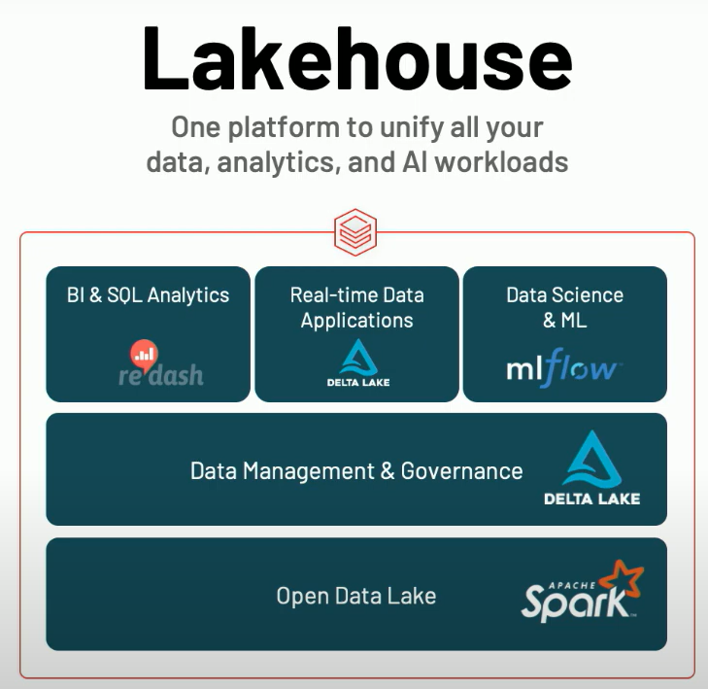
Databricks Overview
Company was founded by the Spark creators
Initial product was basically a web-based notebook experience hosted on enterprise cloud platforms (AWS, then Azure, now also GCP) to make working with Spark easier
The product has evolved over the years into a fully-fledged Lakehouse platform with Spark still at its core but other open-source libraries such as Delta Lake, Mlflow, Koalas, redash tightly integrated.
Scope was initially focus on Data Science, now everything in one platform
Apache Spark + Databricks + Azure Enterprise Cloud = Azure Databricks
Notes:
Clusters are set up, configured, and fine-tuned to ensure reliability and performance without the need for monitoring.

Slide 12
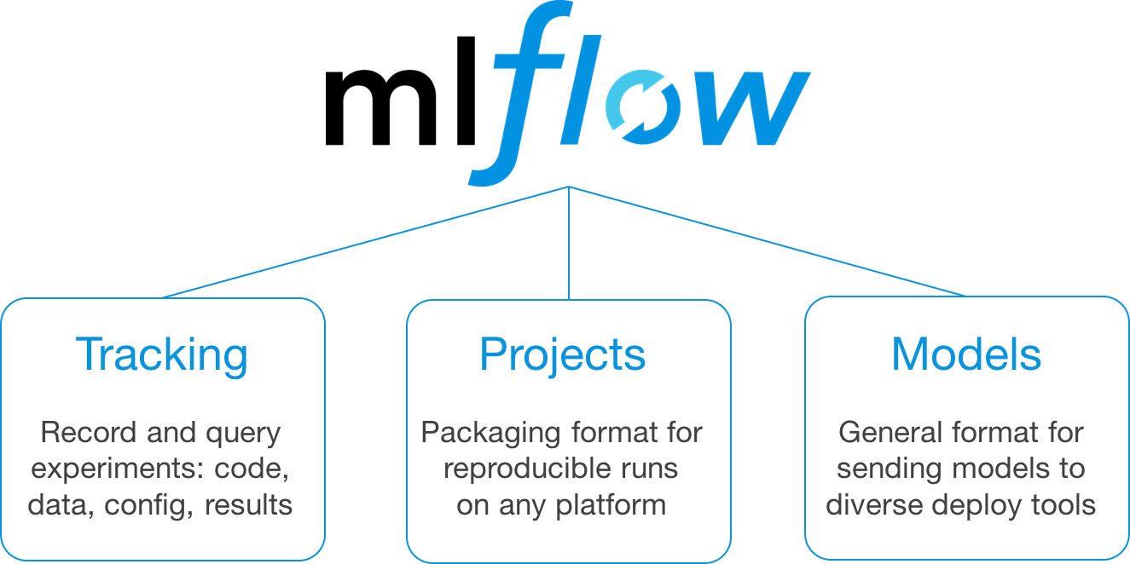
Azure Databricks Apache Spark + Databricks + Enterprise Cloud = Azure Databricks
Start quickly with an optimized Apache Spark environment: Just spin up a cluster and take advantage of autoscaling and auto-termination to improve TCO.
Boost productivity with a shared workspace and notebook experience as well as common languages such as Python, Scala, SQL and R.
Get easy version control with GitHub and Azure DevOps
Turbocharge machine learning on big data: Make use of the Spark MLlib, scikit learn, keras (...) or access advanced automated machine learning capabilities using the integrated Azure Machine Learning service
Receive unmatched levels of performance and scalability for big data processing and data transformations
Notes:
Clusters are set up, configured, and fine-tuned to ensure reliability and performance without the need for monitoring.

Slide 13

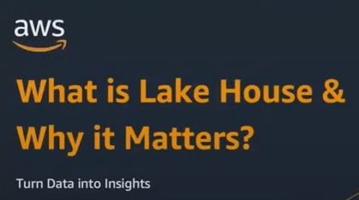
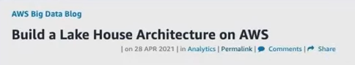
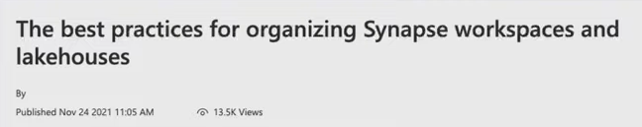
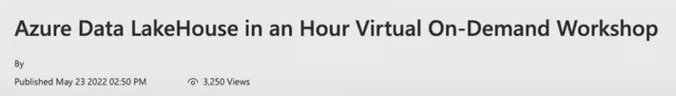

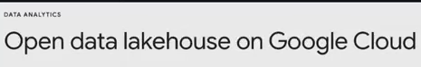
Databricks Overview
Databricks is more than just a Data Science platform. It is a holistic Data platform but as of now particularly shines on Data Science workloads. They have invented the Lakehouse paradigm, which is revolutionizing the data platform industry.
This paradigm has been picked up and prioritized by all major cloud vendors, slowly but surely replacing traditional data warehouse offerings.
Source: Data & AI Summit 2022 Keynote
Notes:
Clusters are set up, configured, and fine-tuned to ensure reliability and performance without the need for monitoring.

Slide 14
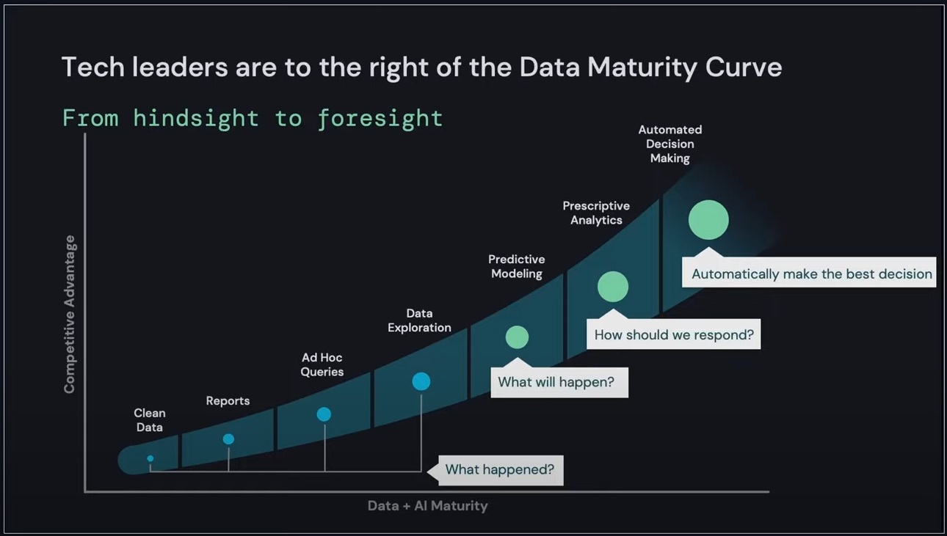
Lakehouse Motivation (1/4)
Source: Data & AI Summit 2022 Keynote
Notes:
Clusters are set up, configured, and fine-tuned to ensure reliability and performance without the need for monitoring.

Slide 15
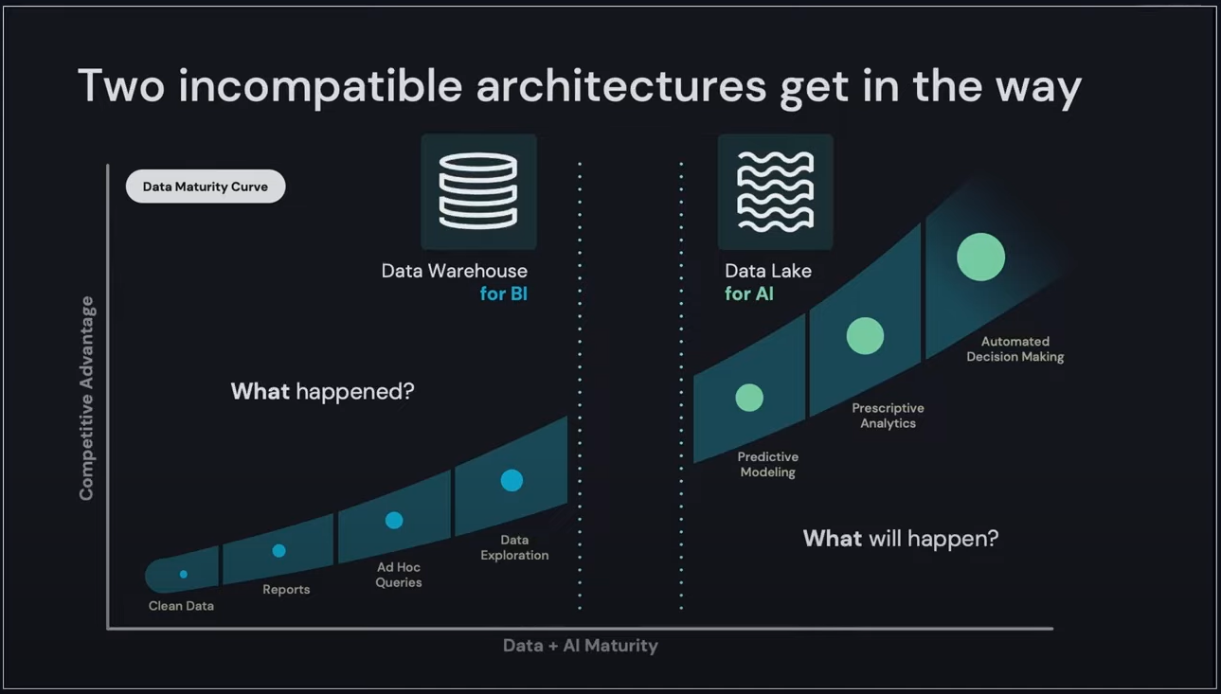
Lakehouse Motivation (2/4)
Source: Data & AI Summit 2022 Keynote
Notes:
Clusters are set up, configured, and fine-tuned to ensure reliability and performance without the need for monitoring.

Slide 16
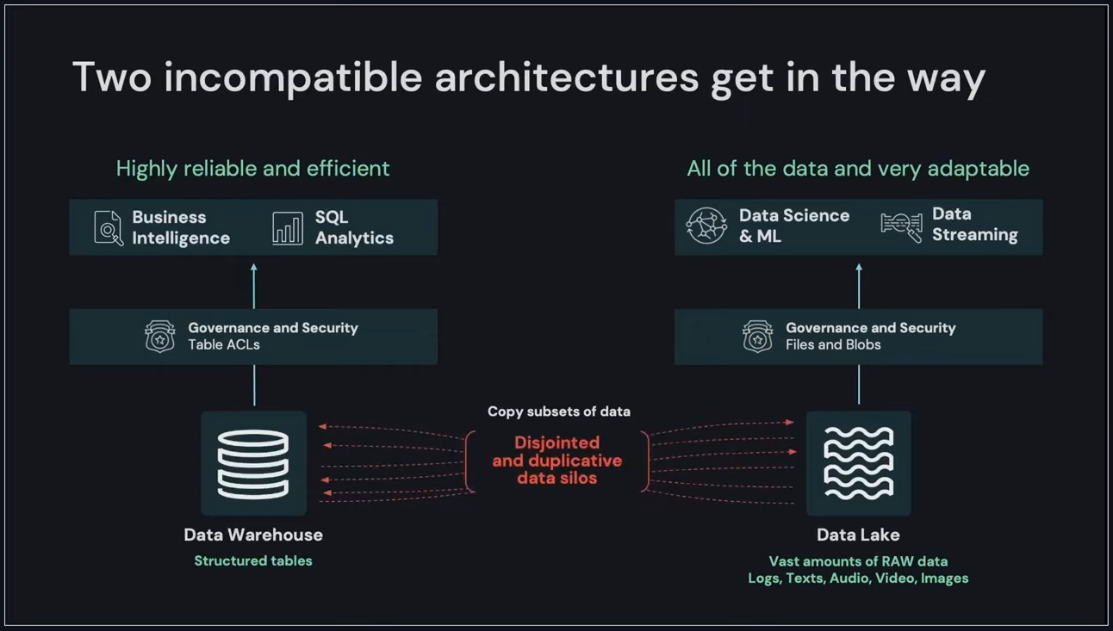
Lakehouse Motivation (3/4)
Source: Data & AI Summit 2022 Keynote
Notes:
Clusters are set up, configured, and fine-tuned to ensure reliability and performance without the need for monitoring.

Slide 17
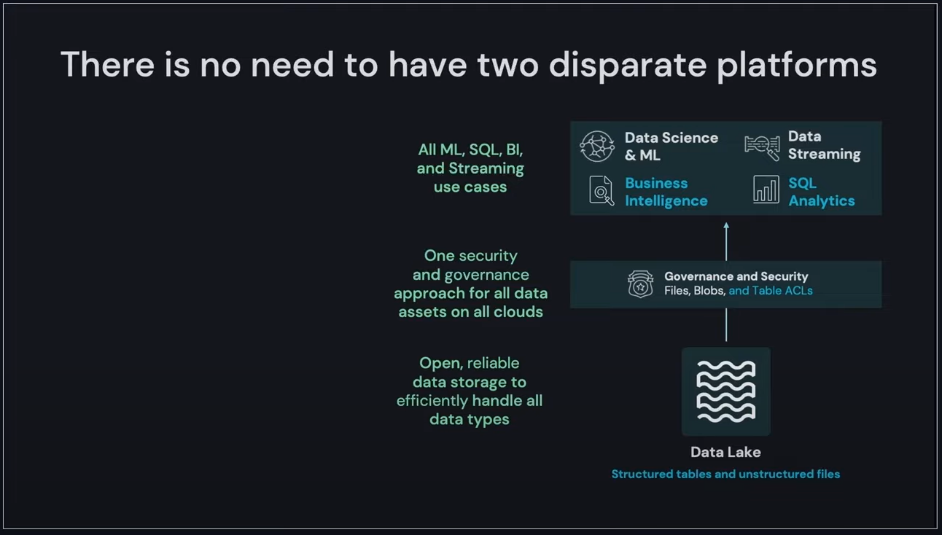
Lakehouse Motivation (4/4)
Source: Data & AI Summit 2022 Keynote
Notes:
Clusters are set up, configured, and fine-tuned to ensure reliability and performance without the need for monitoring.

Slide 18
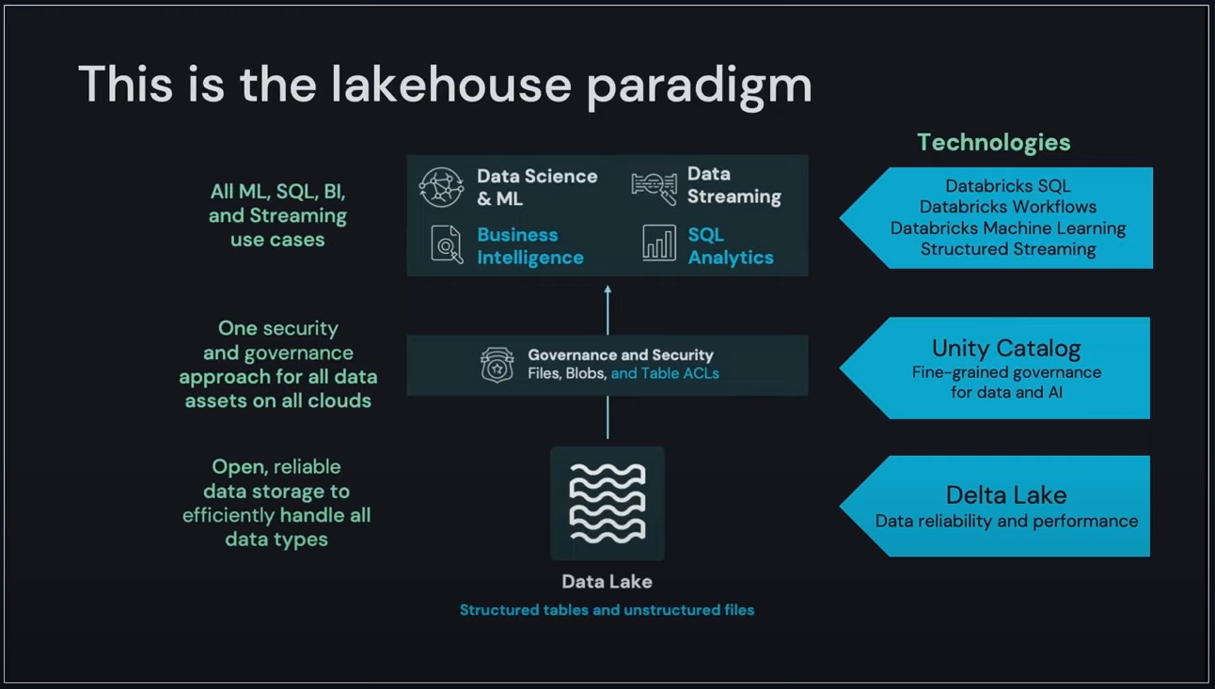
Databricks Lakehouse (1/3)
Source: Data & AI Summit 2022 Keynote
Notes:
Clusters are set up, configured, and fine-tuned to ensure reliability and performance without the need for monitoring.

Slide 19
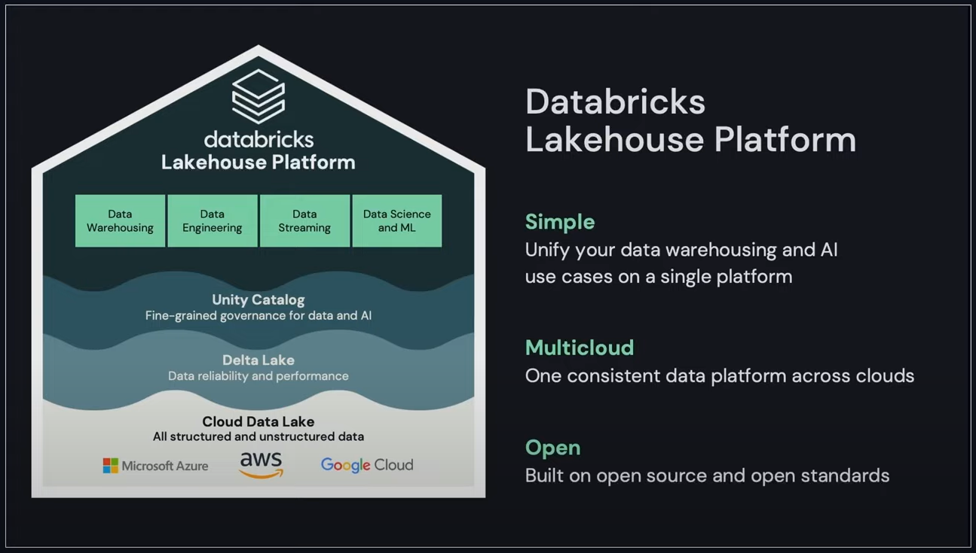
Databricks Lakehouse (2/3)
Source: Data & AI Summit 2022 Keynote
Notes:
Clusters are set up, configured, and fine-tuned to ensure reliability and performance without the need for monitoring.

Slide 20
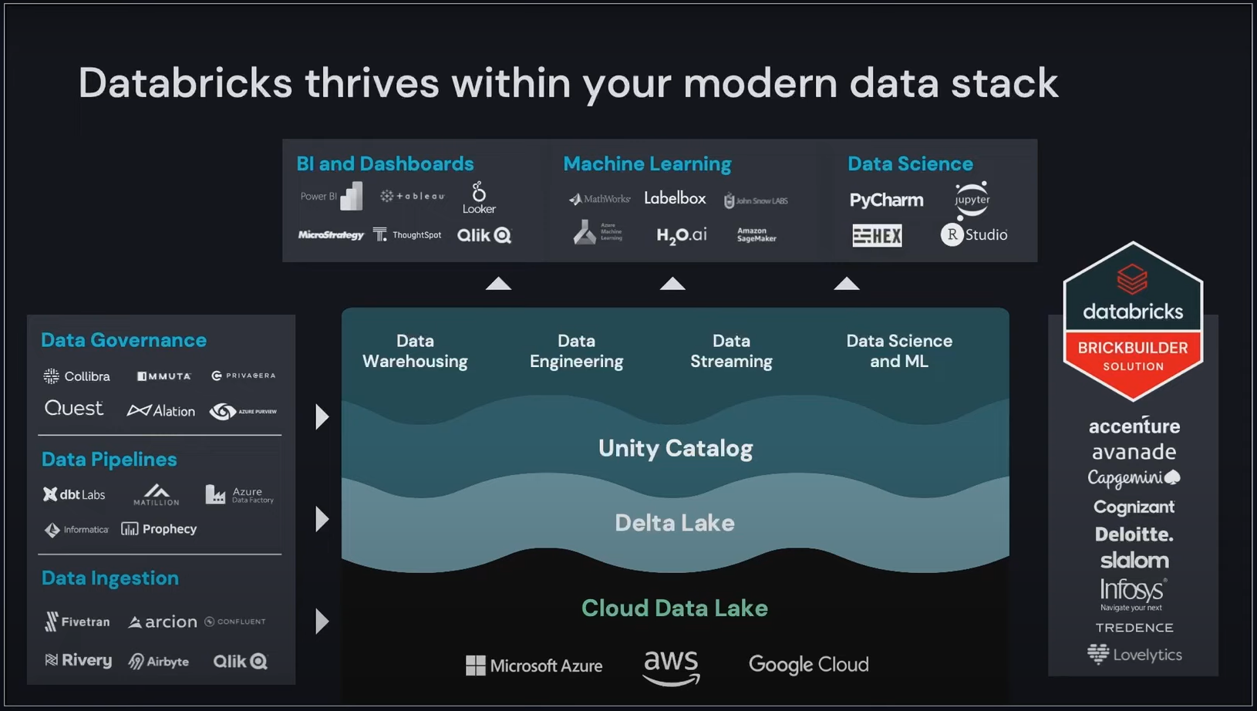
Databricks Lakehouse (3/3)
Source: Data & AI Summit 2022 Keynote
Notes:
Clusters are set up, configured, and fine-tuned to ensure reliability and performance without the need for monitoring.

Slide 21
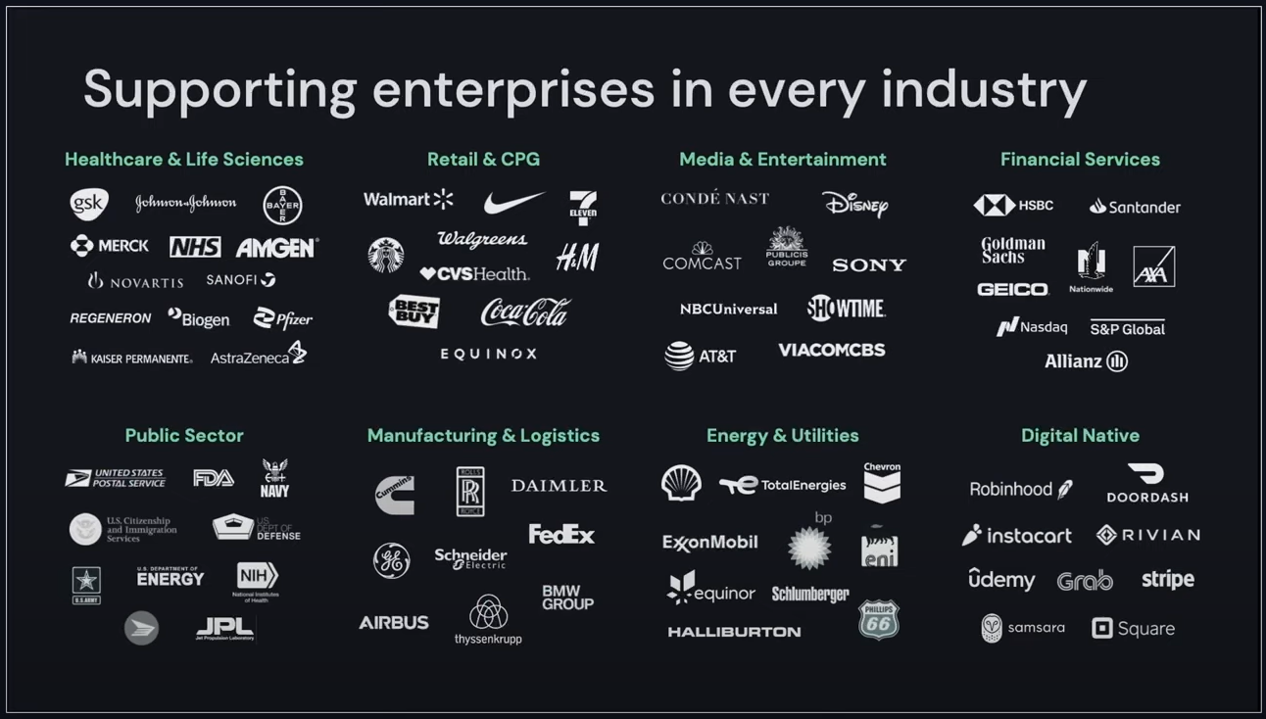
Databricks Industry Offerings
Source: Data & AI Summit 2022 Keynote
Notes:
Clusters are set up, configured, and fine-tuned to ensure reliability and performance without the need for monitoring.

Slide 22
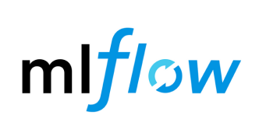

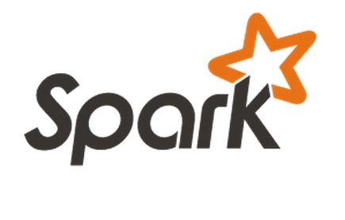
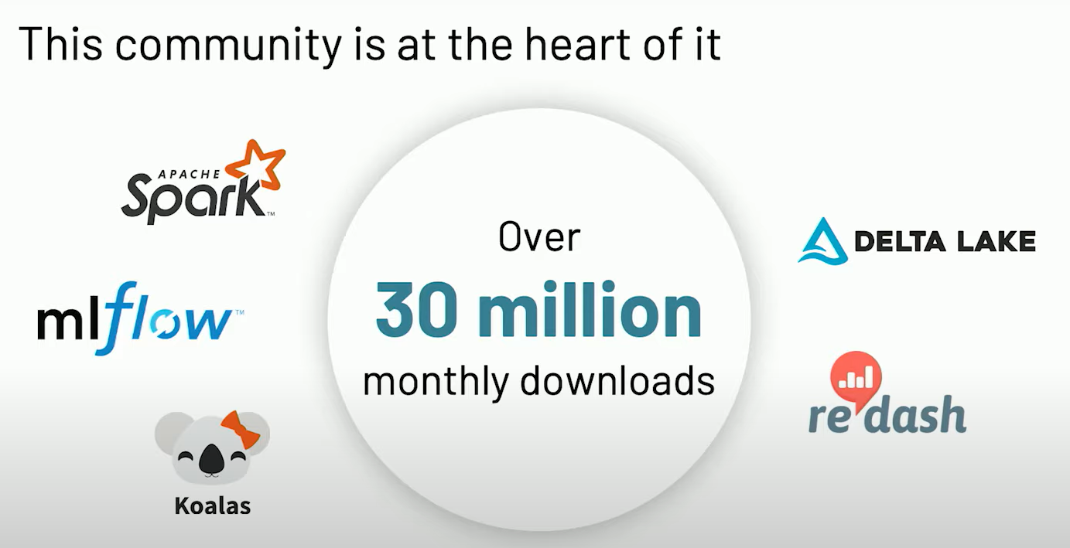
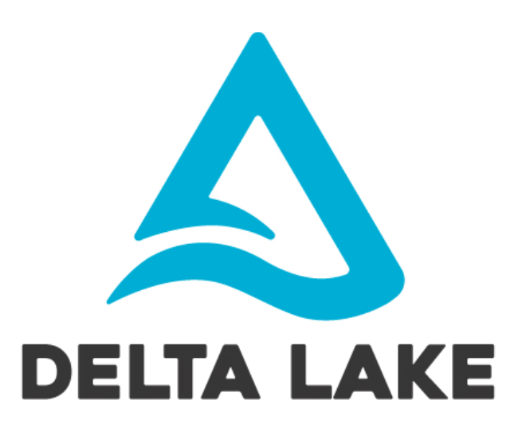
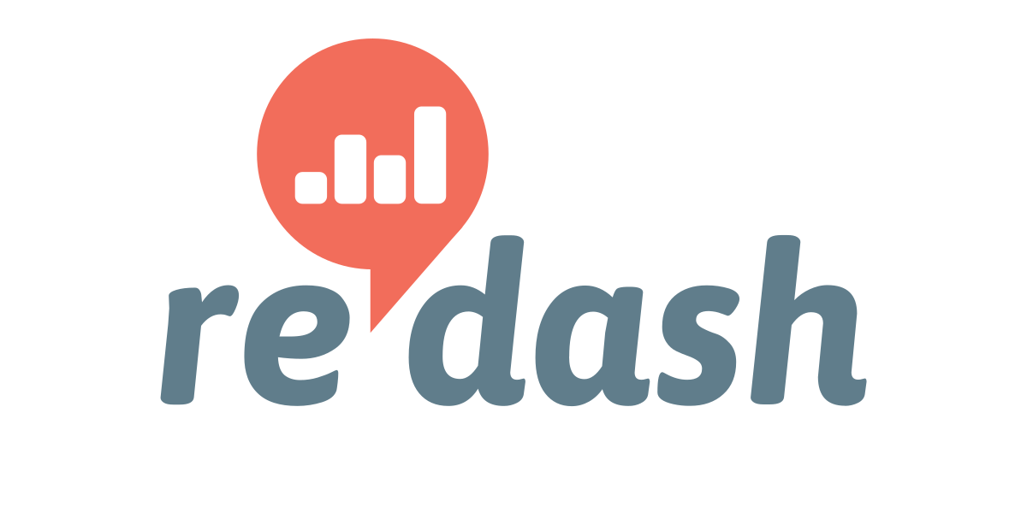
Databricks Open-Source Components
Streamline complete machine learning lifecycle with enterprise reliability, security and scale including development, tracking experiments, packaging code into reproducible runs, sharing and deploying models
Implementation of pandas DataFrame API with Spark backend to provide data scientists a seamless way to scale their existing workloads to big data
Storage layer that brings reliability, security and performance to data lakes. Delta Lake provides ACID transactions, scalable metadata handling, and unifies streaming and batch data processing
Collaborative visualization and dashboarding platform designed to enable anyone, regardless of their level of technical sophistication, to share insights within and across teams.

Slide 23
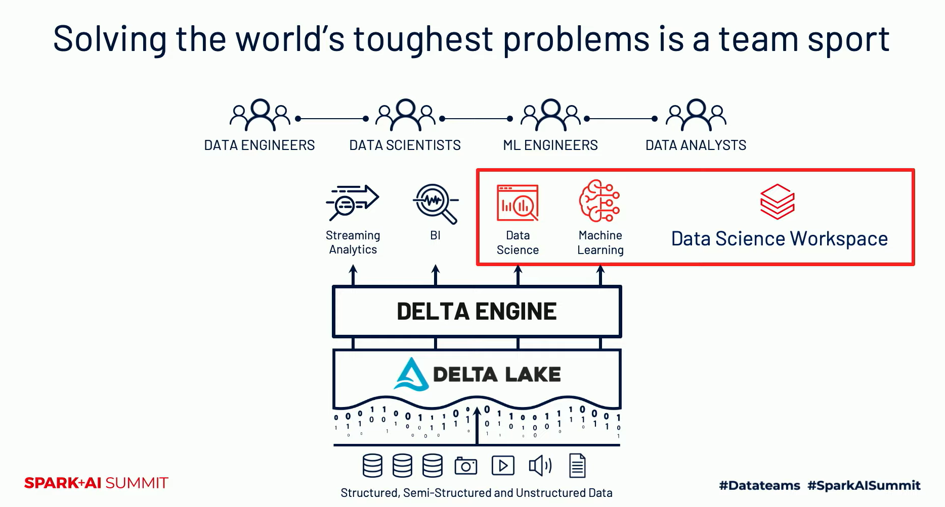
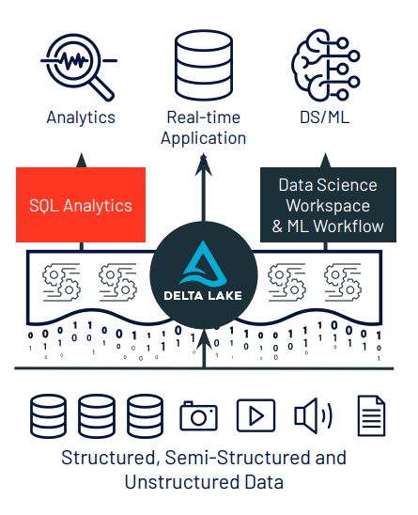
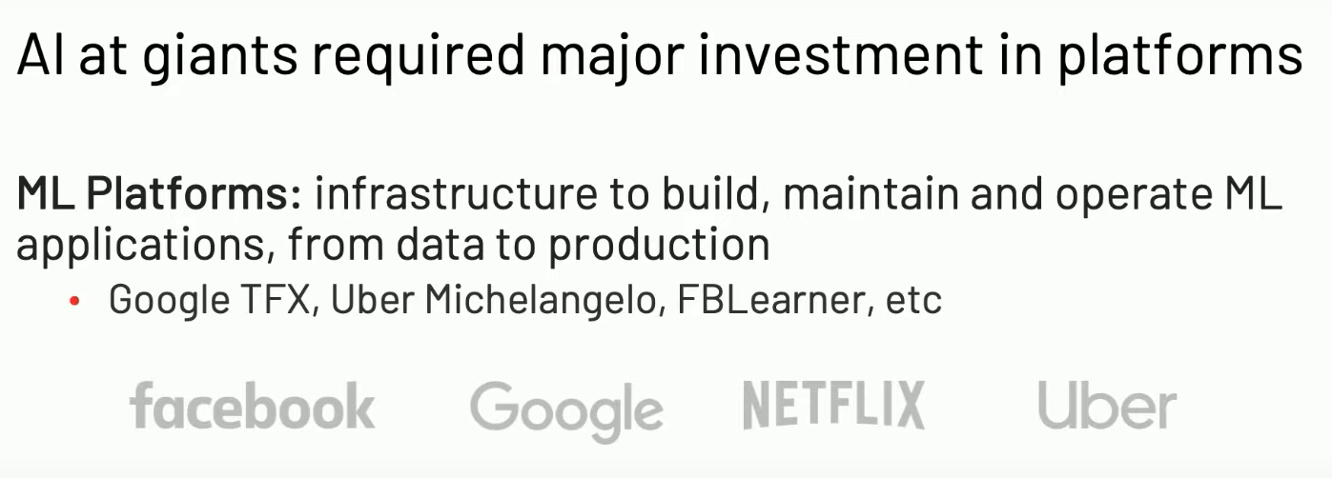
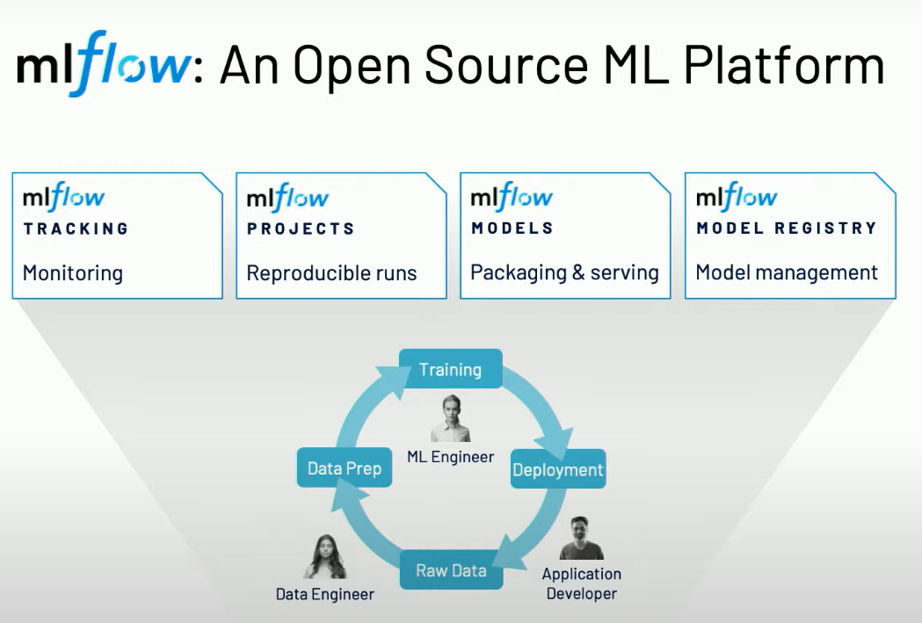
MLflow
What about other companies?

Slide 24
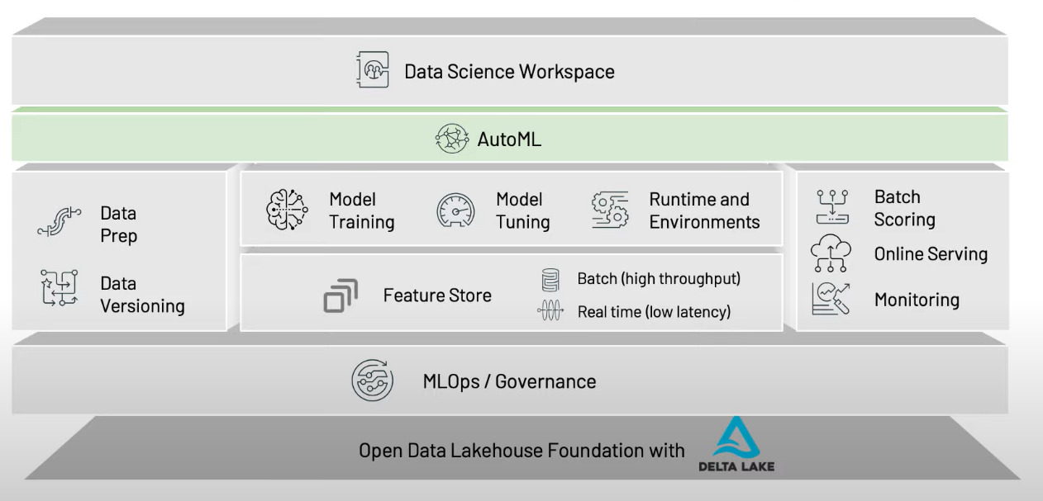
Databricks Data Science Workspace

Slide 25
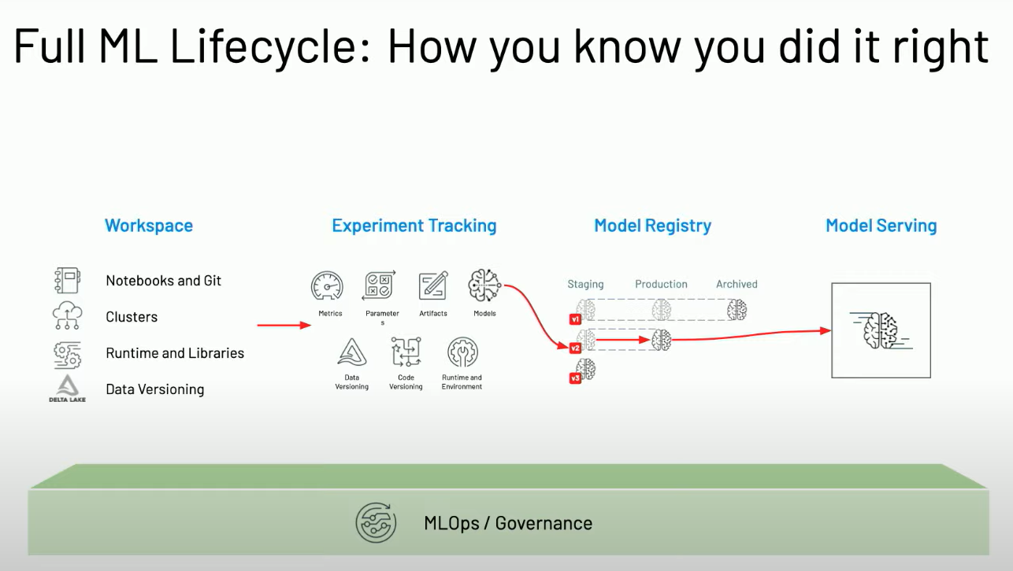
MLflow

Slide 26
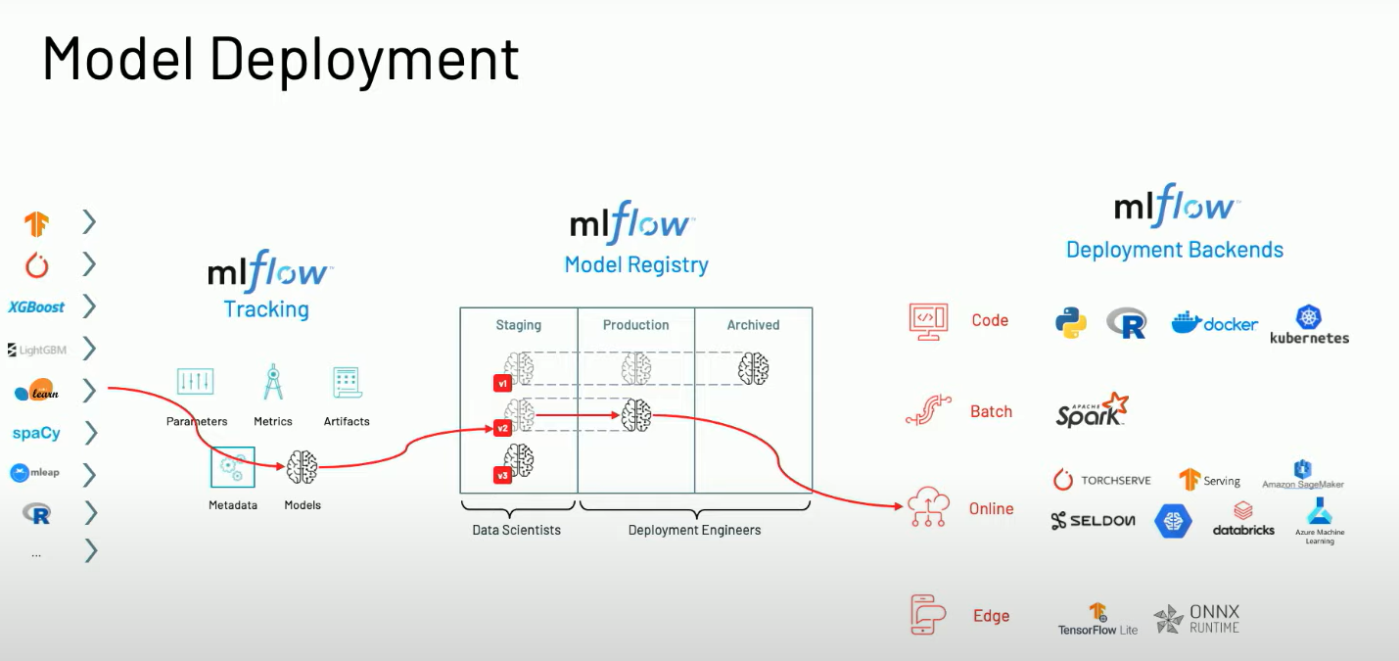
MLflow

Slide 27
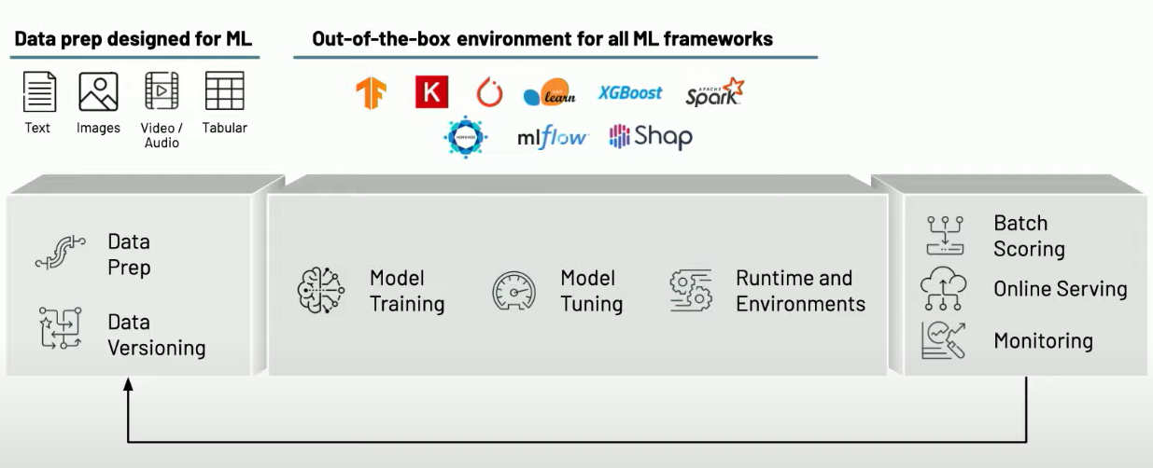
MLflow

Slide 28
MLflow

Slide 29
Azure Databricks Apache Spark + Databricks + Enterprise Cloud = Azure Databricks
Start quickly with an optimized Apache Spark environment: Just spin up a cluster and take advantage of autoscaling and auto-termination to improve TCO.
Boost productivity with a shared workspace and notebook experience as well as common languages such as Python, Scala, SQL and R.
Get easy version control with GitHub and Azure DevOps
Turbocharge machine learning on big data: Make use of the Spark MLlib, scikit learn, keras (...) or access advanced automated machine learning capabilities using the integrated Azure Machine Learning service
Receive unmatched levels of performance and scalability for big data processing and data transformations
Notes:
Clusters are set up, configured, and fine-tuned to ensure reliability and performance without the need for monitoring.

Slide 30
Azure Databricks Apache Spark + Databricks + Enterprise Cloud = Azure Databricks
Start quickly with an optimized Apache Spark environment: Just spin up a cluster and take advantage of autoscaling and auto-termination to improve TCO.
Boost productivity with a shared workspace and notebook experience as well as common languages such as Python, Scala, SQL and R.
Get easy version control with GitHub and Azure DevOps
Turbocharge machine learning on big data: Make use of the Spark MLlib, scikit learn, keras (...) or access advanced automated machine learning capabilities using the integrated Azure Machine Learning service
Receive unmatched levels of performance and scalability for big data processing and data transformations
Notes:
Clusters are set up, configured, and fine-tuned to ensure reliability and performance without the need for monitoring.

Slide 31
Azure Databricks Resources Apache Spark + Databricks + Enterprise Cloud = Azure Databricks
Databricks Documentation: https://docs.databricks.com/?_ga=2.26086267.718267847.1659725083-830162552.1639937423
Start quickly with an optimized Apache Spark environment: Just spin up a cluster and take advantage of autoscaling and auto-termination to improve TCO.
Boost productivity with a shared workspace and notebook experience as well as common languages such as Python, Scala, SQL and R.
Get easy version control with GitHub and Azure DevOps
Turbocharge machine learning on big data: Make use of the Spark MLlib, scikit learn, keras (...) or access advanced automated machine learning capabilities using the integrated Azure Machine Learning service
Receive unmatched levels of performance and scalability for big data processing and data transformations
Notes:
Clusters are set up, configured, and fine-tuned to ensure reliability and performance without the need for monitoring.

Slide 32
Azure Databricks Resources
Databricks Documentation
Azure Databricks Microsoft Documentation
Apache Spark Documentation
MLflow Documentation
Databricks Partner Portal
Databricks Partner Academy
Avanade Databricks League
Learning Spark 2nd Edition Book
Advaned Analytics Youtube Channel by Simon Whiteley
Data + AI Summit 2022
Notes:
Clusters are set up, configured, and fine-tuned to ensure reliability and performance without the need for monitoring.

Slide 33
Data Science with Databricks Lab
Machine Learning at Scale with Apache Spark, Koalas & MLflow
Notes:
Blue: need Azure

